Slide 1
Advanced Topics

Slide 2
Visuospatial Reasoning

Slide 3
Visuospatial Reasoning
Constraint Propagation
Visuospatial Reasoning

Slide 4
Visuospatial Knowledge: Knowledge wherein causality is, at most, implicit.

Slide 5
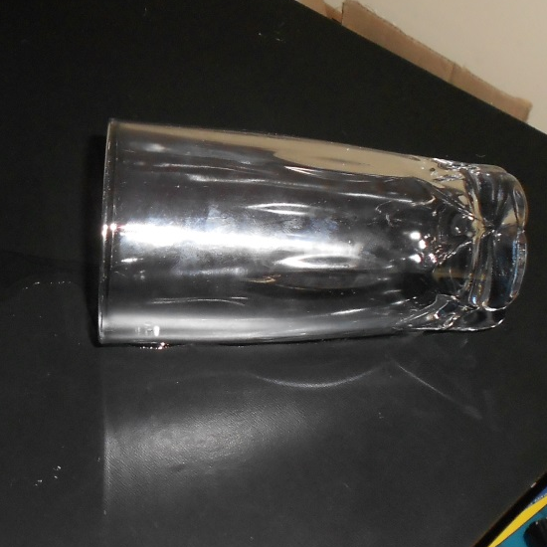
Visuospatial Knowledge: Knowledge wherein causality is, at most, implicit.

Slide 6
Shape
name : x
shape : triangle
rotation : 90°
Shape
name : x
shape : triangle
rotation : 270°

Slide 8
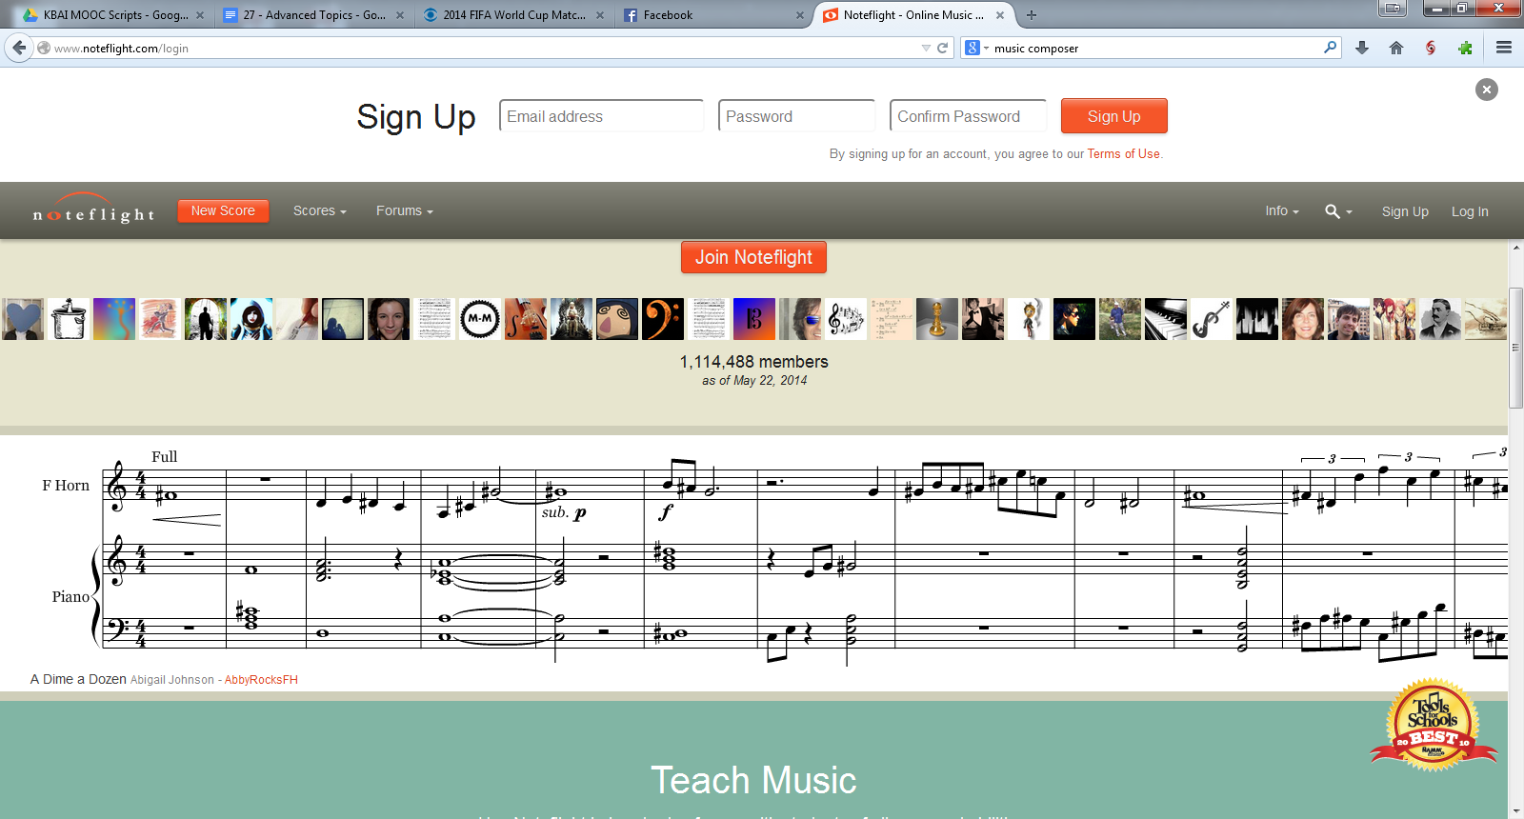
Measure
key : G
style : pop
tempo : 90
Measure
key : B
style : pop
tempo : 90

Slide 10
 | Visuospatial | Verbal
Content | Appearance: What and Where | Arbitrary: Driven by Inferential Needs
Encoding | Analogical: Structural Correspondence | Propositional: No Correspondence

Slide 11
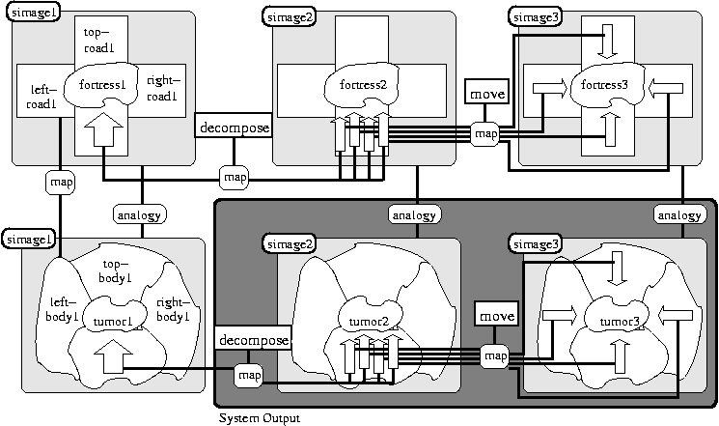

Slide 12
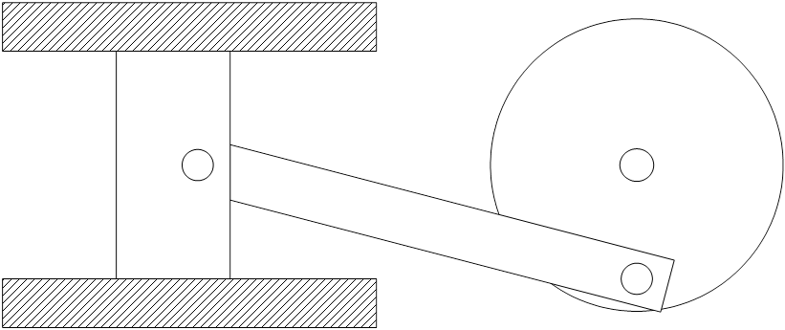

Slide 13
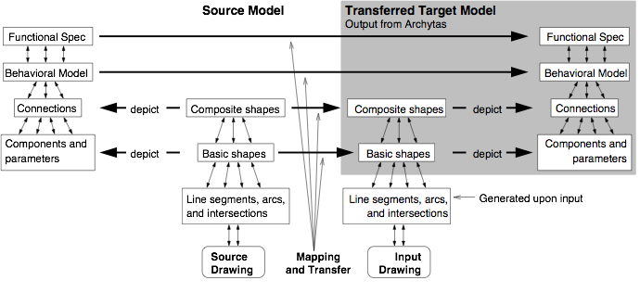

Slide 14
A
B
C
5
z
y
t
s
x
y
x
s
r
r
x
unchanged
x
r
unchanged
r
inside
above
inside
above
above
y
expanded
y
above
s
unchanged
s
above
above
z
deleted
z
t
deleted
t

Slide 15
A
B
C
5

Slide 16
Systems Thinking

Slide 17
Systems Thinking:
Reasoning about systems with numerous components and processes at multiple, potentially invisible, levels of abstraction.

Slide 18
Today, an extremely serious earthquake of magnitude 8.5 hit Lower Slabovia, killing 25 people and causing $500 million in damage. The President of Lower Slabovia said that the hard-hit area near the Sadie Hawkins fault has been a danger zone for years.
Write a frame representation of this story on the right.
Today, the President of Lower Slabovia killed 25 proposals totaling $500 million for research in earthquake prediction. Our Lower Slabovian correspondent calculates that 8.5 research proposals are rejected for every one approved. There are rumors that the President's science advisor, Sadie Hawkins, is at fault.

Slide 19
Restaurant Script
Script
script : restaurant
track : formal dining
props : tables, menu, check,
money, F = food, P = place
roles : S = customer, W = waiter,
C = cook, M = cashier,
O = owner
entry : S is hungry, S has money
result : S has less money,
O has more money,
S is not hungry,
S is pleased
scenes :

Slide 20
Data Space
D₁
D₂
D₃
D₄
D₅
D₆
D₇
D₈
D₉
…
D_{N}
Hypothesis Space
H₁
H₂
H₃
H₄
H₅
H₆
H₇
H₈
H₉
…
H_{N}
Treatment Space
T₁
T₂
T₃
T₄
T₅
T₆
T₇
T₈
T₉
…
T_{N}
Map
Abstract
Refine

Slide 21
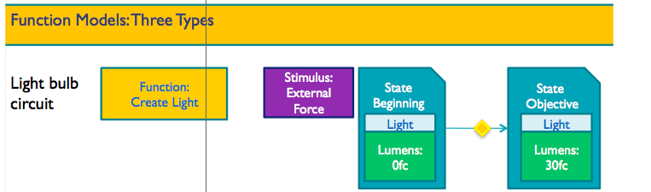

Slide 22
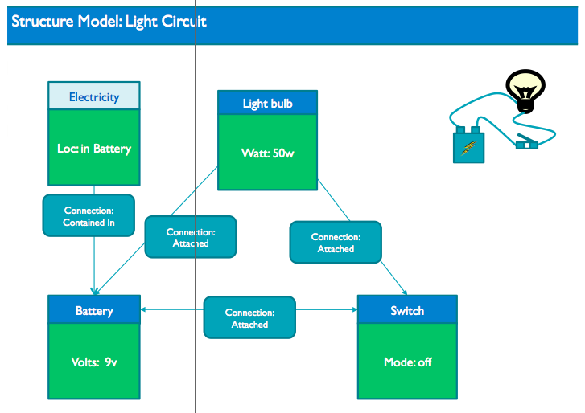

Slide 23
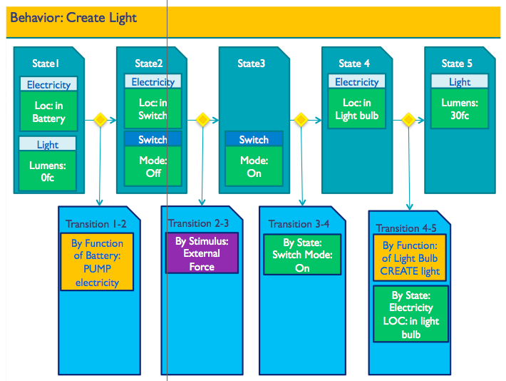

Slide 24
Design

Slide 25
Design & Creativity
Configuration
Diagnosis
Design
Creativity

Slide 26
Design Thinking:
Reasoning about ill-defined, unconstrained, open problems that are situated in the world.

Slide 27
Chair Legs
count : 4
size : 25g
material : wood
cost : $5.00
Order:
A chair that weighs over 200g, costs at most $20 to make, and has 4 legs.
Chair
mass : 250g
cost : $20
legs :
seat :
arms :
back :
Chair Seat
size : 50g
material : metal
cost : $5.00
Chair Arms
size : 50g
material : metal
cost : $5.00
Materials Table
Material | Cost per gram
Plastic | $0.01
Wood | $0.05
Metal | $0.10
Chair Back
size : 50g
material : metal
cost : $5.00
Notes:
Image credit:
https://commons.wikimedia.org/wiki/File:Chair_4a.jpg

Slide 28
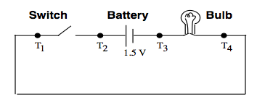

Slide 29
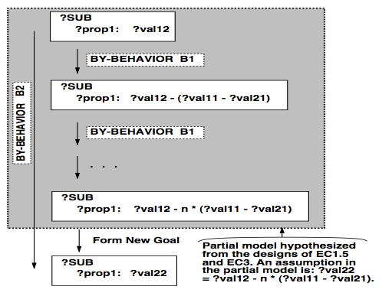
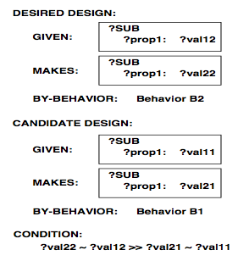

Slide 30
Creativity

Slide 31
What is creativity?
Please also post your answer on the class forum.
A non-obvious, desirable product.

Slide 32
Something is creative
if it is…
Novel
Valuable
Unexpected
Some other processes of creativity:
Emergence
Re-representation
Serendipity

Slide 33
For each of the following tasks, mark the box if successful completion of a task would mean that the agent is creative.
ο Performing well on Raven’s Progressive Matrices
ο Solving the stacked blocks problem
ο Configuring a chair based on input parameters
ο Diagnosing an illness in a patient
ο Designing a route to a new destination
ο Correctly classifying new types of animals
ο Using a chair to prop open a door
ο Deciding between multiple strategies for a problem
ο Designing a new car based on a new fuel source

Slide 34
Do you agree with David’s assessment that none of these results are creative because we can trace through the underlying process that led to them?
ο Yes, because in order for a result to be creative, it must be novel, and output of an algorithm cannot be novel.
ο Yes, because given a set of input, the output will always be the same; therefore, the product can never be unexpected.
ο No, because it defines creativity in terms of the output rather than the process.
ο No, because under this definition, humans are only considered creative because we don’t know how the brain works yet.

Slide 35
AI Ethics

Slide 36

Visuospatial Reasoning: Reasoning wherein causality is, at most, implicit.

